Slide 1

Cleveland Live Music
CWRU Bootcamp Group Project One
Rhonda Johnson Stacie Knisley Brian Macauley Jason Way

Slide 2
CLM Application Concept
Cleveland Live Music or
CLM
is a resource of
Live Musical Performances
in Northeast Ohio
User selects an upcoming date and the API Songkick pulls all data in the area about
Live Music events

Slide 3
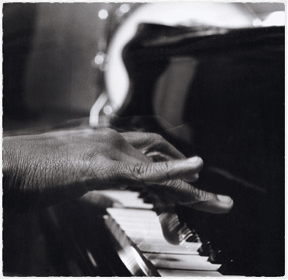

Motivation to Create CLM
To provide Live Music enthusiasts who reside or are visiting Northeast Ohio an easy to use resource to locate Live Musical performances.
Information about upcoming Live Music is quickly accessible using a mobile device or computer.

Slide 4
Stories from Users
A user would like to see live music…
Not sure where, when or who?
“Roland Rocker” (band member)- Follows other bands and music festivals in Northeast Ohio.
“Rocky” (Hall of Fame Fan) - Visiting the Rock & Roll Hall of Fame and would like to see live music.
“Renetta” (resident of Cleveland) is looking for live entertainment this weekend.
“Ralph” is traveling for work or fun to Northeast Ohio and would a night out to enjoy a live band with coworkers, friends and family.

Slide 5
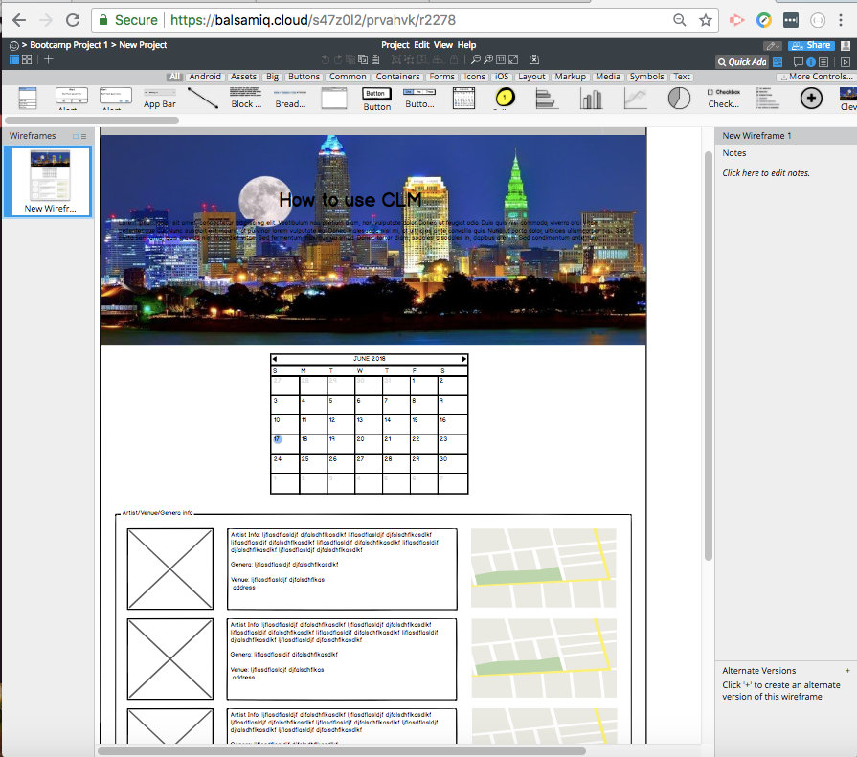
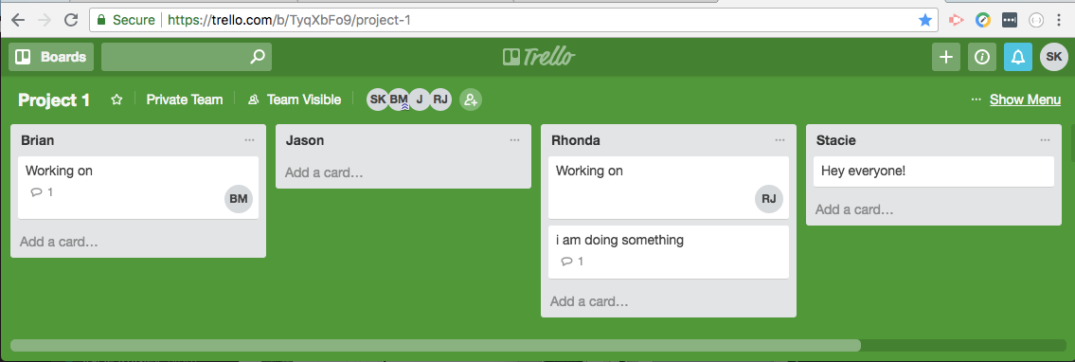
Design Process
Wireframe in Balsamiq
trello.com boards
Header Panel with Title
Calendar to select date
Table populated with musical performances
Map to easily find location
Musical performer’s names link to Facebook

Slide 6
Design Process
Delegating. Each member volunteered different areas of the project.
Rhonda - APIs, JAVA
Macauley - Calendar
Jason - Maps
Stacie - HTML, CSS

Slide 7

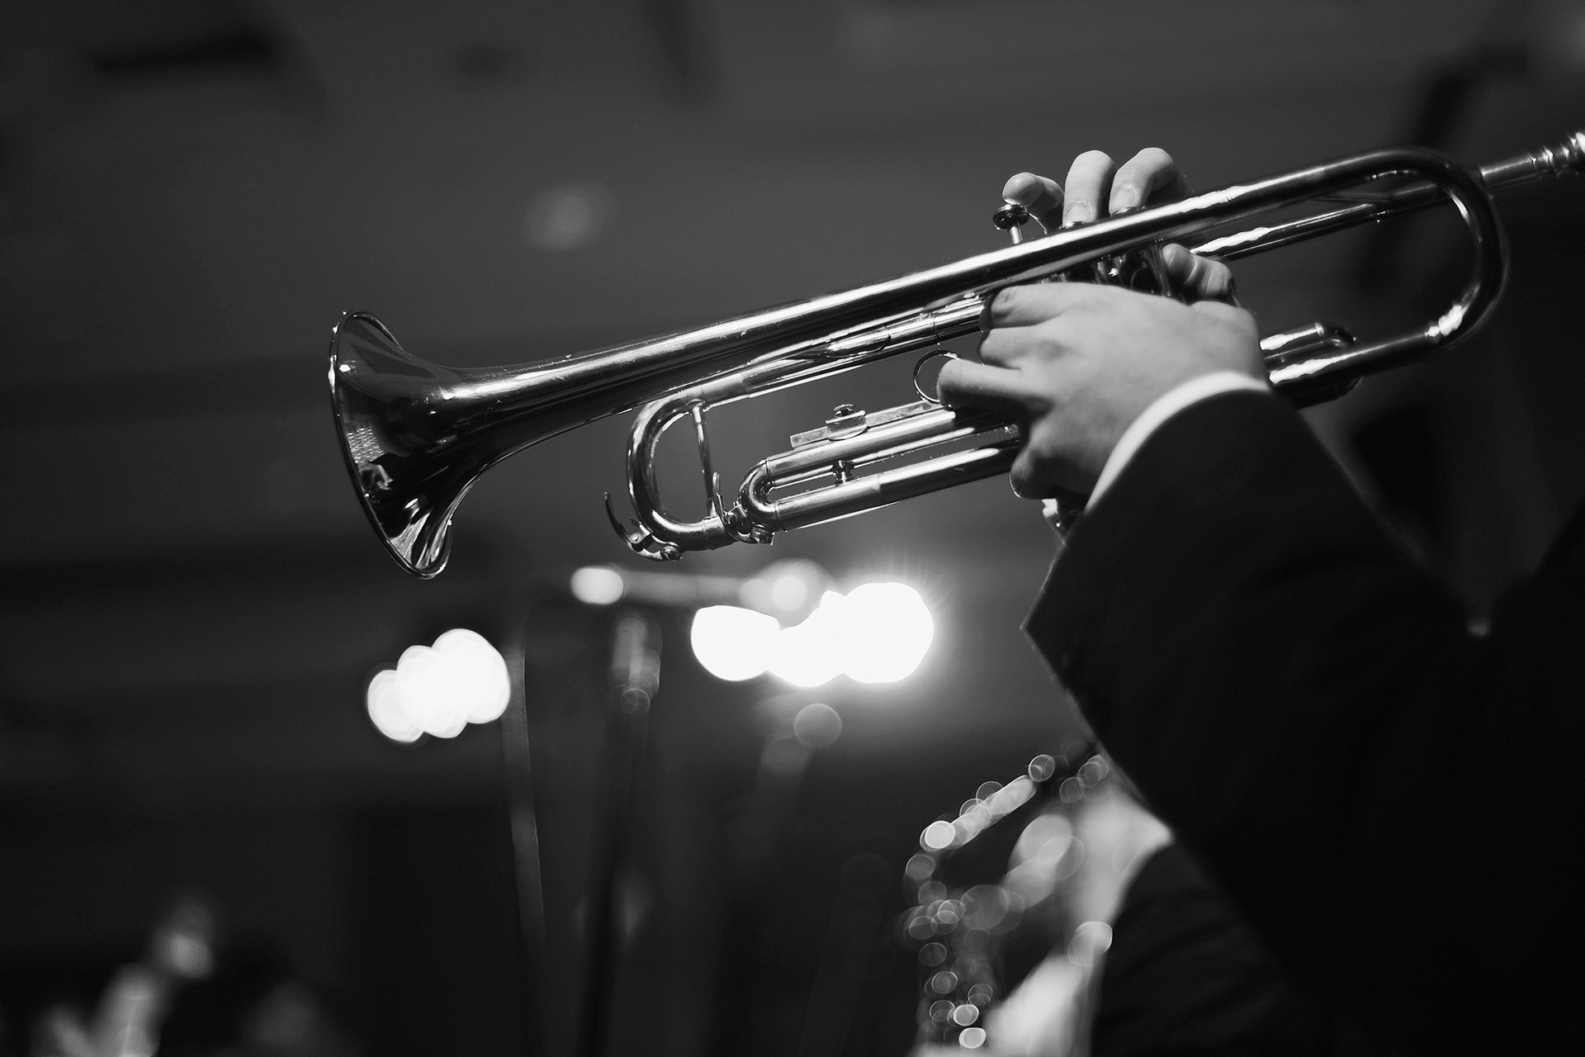
Technologies
CSS
Bootstrap
Javascript jQuery
JSON
jQuery Modal
AJAX
Moment
Mapbox GL JS
Bootstrap Datepicker

Slide 8

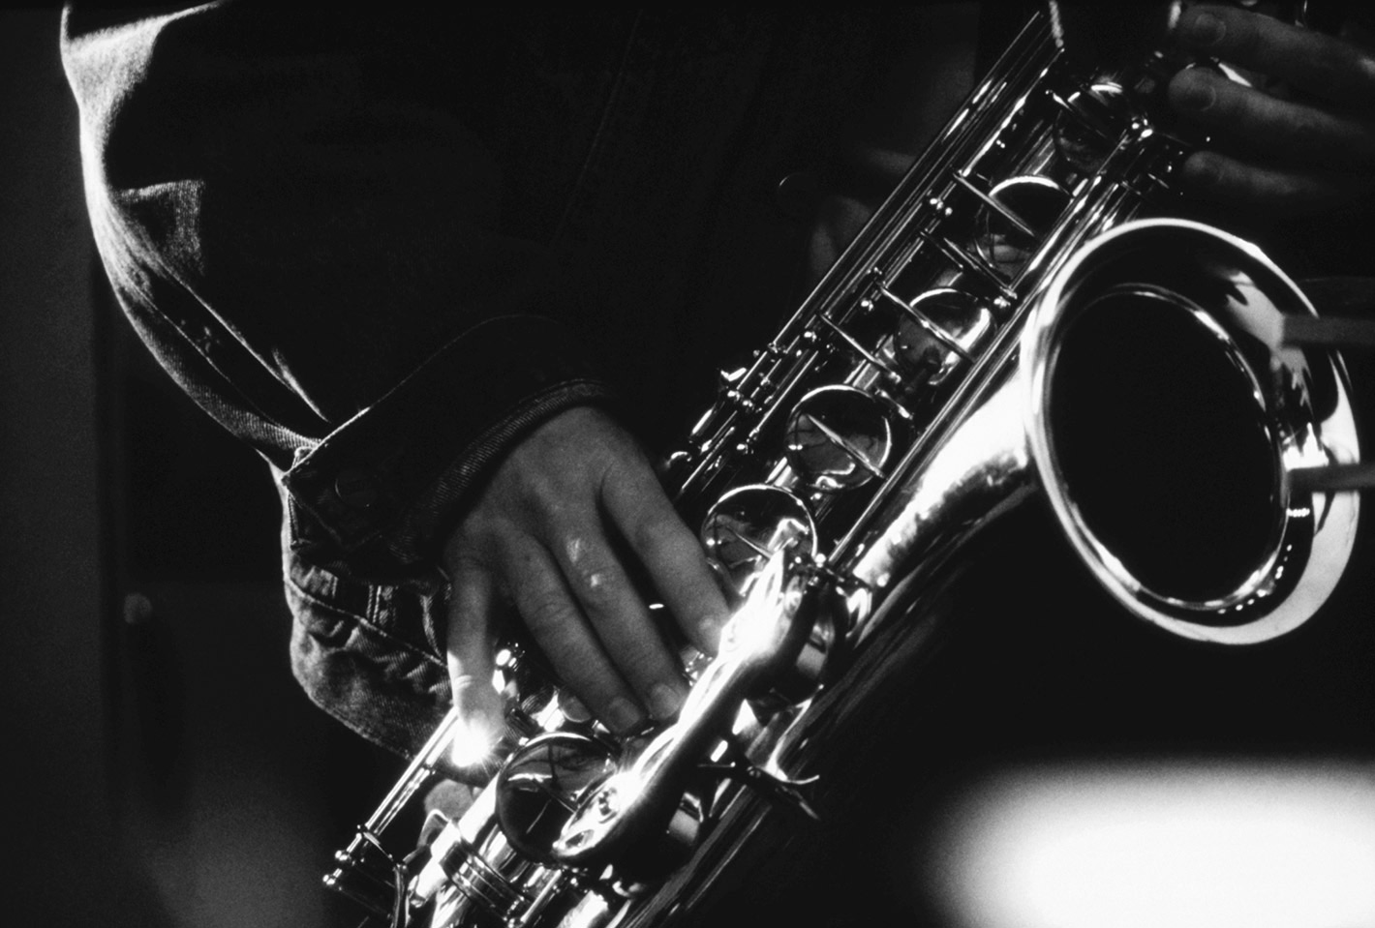
Technologies APIs
Songkick - search events by date and time, performers, venue and location
Bandsintown - URL for pictures and Facebook link for event headliner

Slide 9
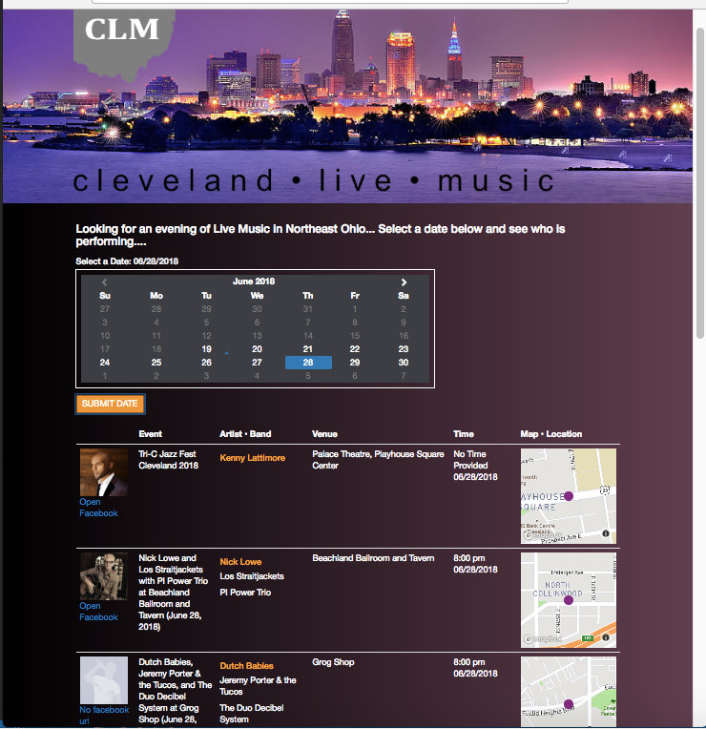
Challenges
GitHub
Javascript
Maps/Calendar
Collaborating as a group

Slide 10
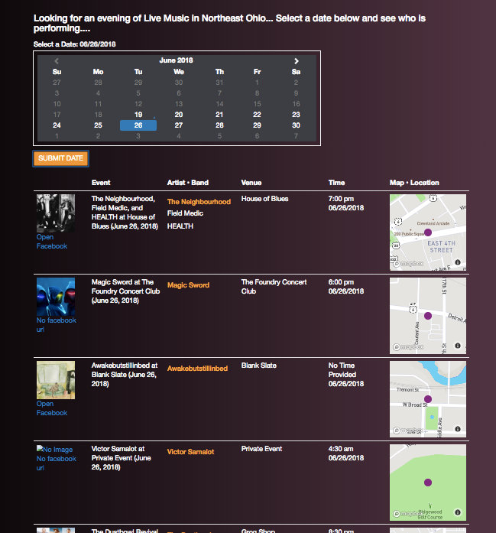
Javascript Challenges
Determining the query URLs for the APIs
Replacing special characters and strings
Order of links and scripts in HTML header
Maximum amount of Maps for display

Slide 11
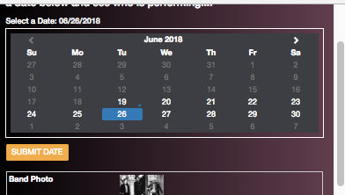
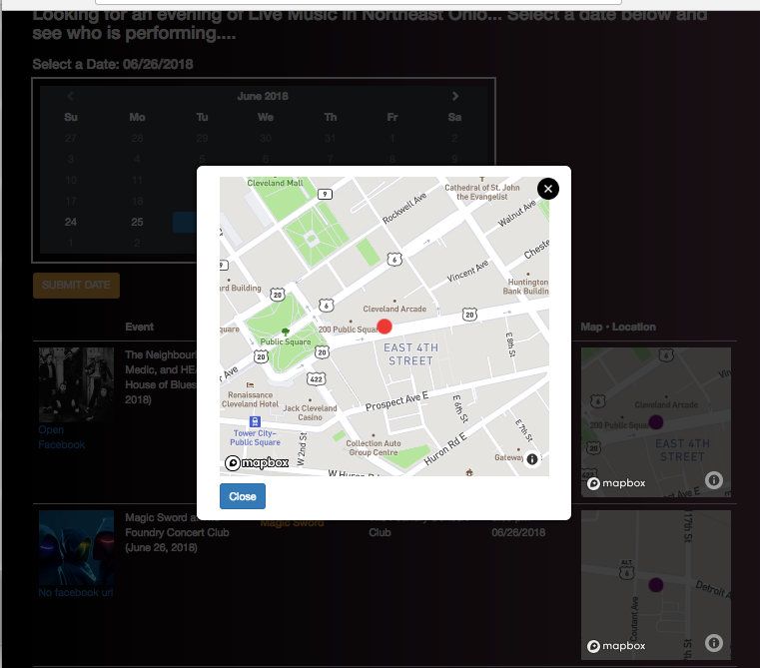
Calendar & Map Challenges
Maps - display in HTML
Google Maps
Two different types calendars in Bootstrap
Responsive

Slide 12
Future Updates
Audio sample of music plays when artist or band is select
Firebase data is returned about favorites
Information or links to purchase event tickets
Past performances displayed in calendar
Options to purchase artist or band merchandise

Slide 13
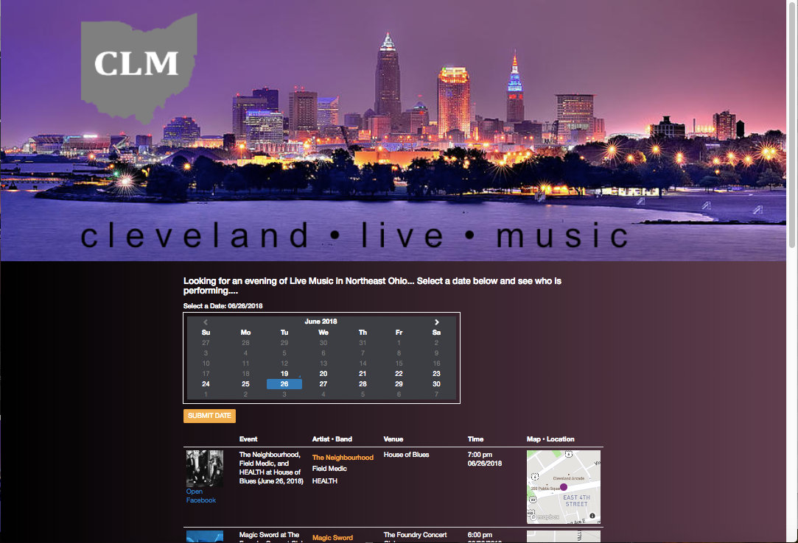
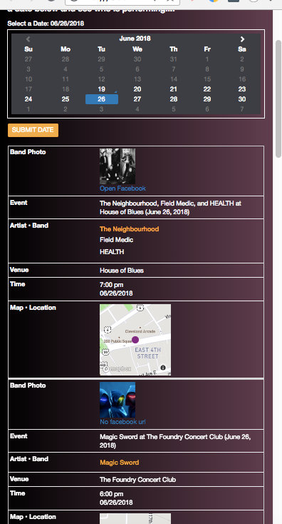
Demonstration

Slide 14
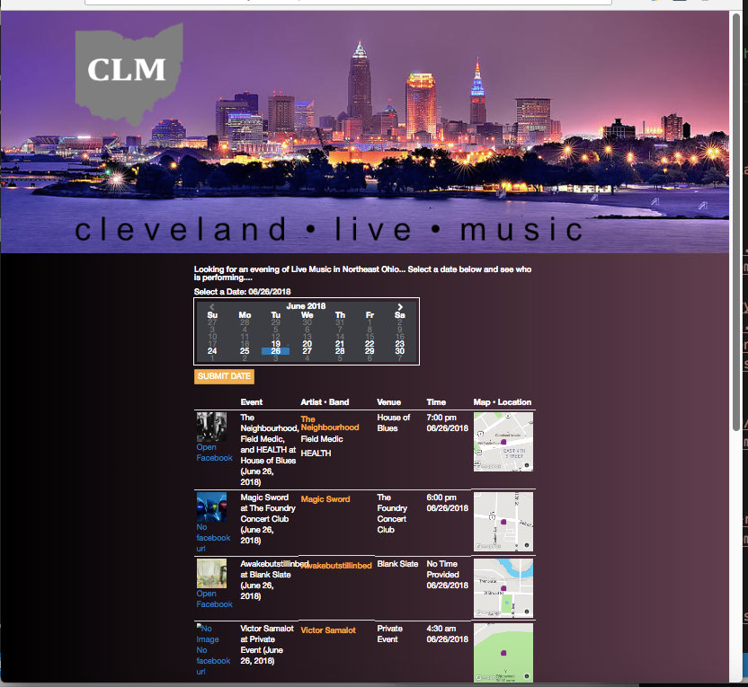
Questions 0r Comments
Rhonda Johnson Stacie Knisley Brian Macauley Jason Way

